Slide 1

Context Aware Image Caption Generation Using Deep Learning Algorithm Mohammad Sina Hassannia , Sumon Kanti Dey and Lovely Yeswanth Panchumarthi March 27, 2025

Slide 2
Introduction to the Problem
Image captioning is the task of describing the content of an image in natural language.
Traditional image captioning focuses on describing objects and actions in an image.
Context-aware captioning requires:
Understanding visual content (objects, scenes, actions).
Captures intent, interactions, and background details
Importance:
Facilitates Dataset Annotation
Helps visually impaired users understand image content through descriptive text
Enables Visual Question Answering (VQA)
Enables Cross-lingual Applications.
Improves E-commerce Experience
Application
Social Media Automation
Human-Robot Interaction
Education and Assistive Tools
Introduction
Data Overview
Methodology
Objective & Goals
Teams Contribution
Next Steps

Slide 3
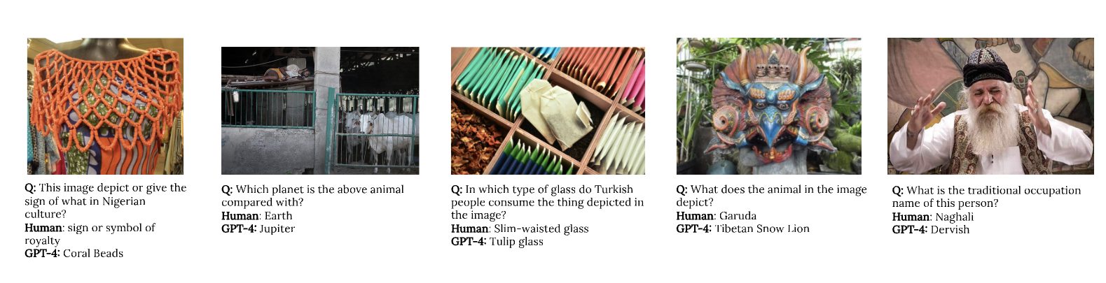
Why it is important
Nayak, Shravan, Kanishk Jain, Rabiul Awal, Siva Reddy, Sjoerd Van Steenkiste, Lisa Anne Hendricks, and Aishwarya Agrawal. "Benchmarking vision language models for cultural understanding." arXiv preprint arXiv:2407.10920 (2024).
Introduction
Data Overview
Methodology
Objective & Goals
Teams Contribution
Next Steps

Slide 4
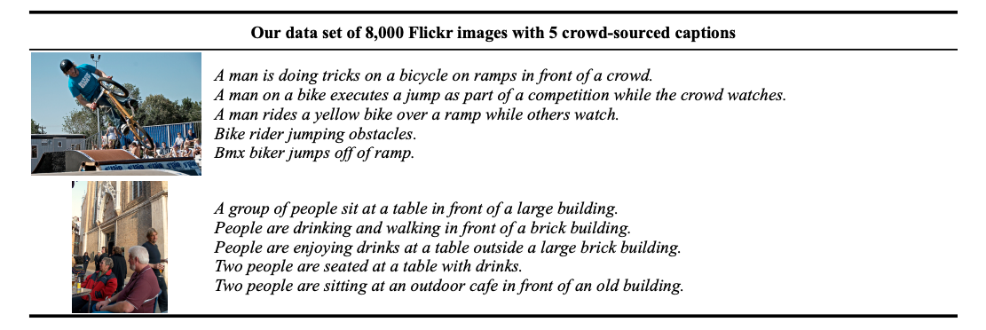
Data Overview
Flickr8k Dataset Overview
Benchmark dataset for image-to-text description tasks.
8,000 real-world images, each paired with 5 human-annotated captions.
Captions focus on events, actions, and scenes.
Exclude famous people and landmarks – ensuring general applicability.
Split details:
6K training, 1K validation, 1K test images
Preprocessing:
Text Preprocessing : Remove special characters, Convert all captions to lowercase.
Image Preprocessing: Resize images - Normalize pixel values
Hodosh, Micah, Peter Young, and Julia Hockenmaier. "Framing image description as a ranking task: Data, models and evaluation metrics." Journal of Artificial Intelligence Research 47 (2013): 853-899.
Introduction
Data Overview
Methodology
Objective & Goals
Teams Contribution
Next Steps

Slide 5
Methodology
Image captioning is a multimodal task, requiring the integration of visual and textual data.
we drew inspiration from autoencoder-like architectures, where:
The encoder processes visual information (image),
the decoder generates the corresponding textual description (caption).
Architecture Overview
Encoder:
A CNN-based model (e.g., ResNet) extracts high-level image features from the input.
Decoder:
A language model (e.g., LSTM, Transformer) takes the image features and generates a caption word-by-word.
This encoder-decoder setup bridges vision and language modalities by compressing visual content and decoding it into human-readable text.
Introduction
Data Overview
Methodology
Objective & Goals
Teams Contribution
Next Steps

Slide 6
Objectives & Goals
Evaluation Metrics:
BLEU: Measures n-gram overlap between generated and gold captions.
METEOR: Considers precision, recall, and word alignment using stemming and synonyms.
ROUGE: Measures n-gram and sequence overlap between generated and reference captions.
Primary Objective:
Build an image captioning system using encoder and decoder base models.
Leverage pre-trained models for robust vision-language integration.
Goals:
Achieve reliable caption accuracy based on aforementioned evaluation metrics.
Ensure fluent captions generation.
Establish a strong baseline for Flickr8k dataset (8,091 images, 40,455 captions).
Introduction
Data Overview
Methodology
Objective & Goals
Teams Contribution
Next Steps

Slide 7
Teams Contribution
Mohammad Sina Hassannia
Collected relevant data for the project
Data preprocessing
Designed the methodology framework
Implemented the model
Contributed to proposal writing
Created slides for presentations
Sumon Kanti Dey
Refined the problem statement
Designed the research methodology
Implemented the model
Assisted in writing the proposal
Designed presentation slides
Data preprocessing
Lovely Yeswanth Panchumarthi
Data Preprocessing.
Designed the research methodology
Implemented the model
Assisted in writing the proposal
Designed presentation slides
Introduction
Data Overview
Methodology
Objective & Goals
Teams Contribution
Next Steps

Slide 8
Next Steps
Model Optimization
Fine-tune encoder (e.g., ResNet) and decoder (e.g., LSTM/Transformer) for improved accuracy.
Experiment with advanced architectures (e.g., attention mechanisms) to enhance context awareness.
Dataset Expansion
Incorporate larger datasets (e.g., MS COCO) to improve generalization.
Add diverse image-caption pairs to capture varied contexts and intents.
Handling Challenges
Address bias in dataset captions and improve fairness.
Optimize the model for efficiency and scalability.
Challenges and Considerations
Overfitting on limited data (Flickr8k’s 8K images).
Balancing computational cost with performance on resource-heavy models.
Ensuring captions reflect nuanced interactions and cultural contexts.
Introduction
Data Overview
Methodology
Objective & Goals
Teams Contribution
Next Steps

Slide 9
Thank you for your Attention
Any Questions ?

Slide 10
References
Hodosh, Micah, Peter Young, and Julia Hockenmaier. "Framing image description as a ranking task: Data, models and evaluation metrics." Journal of Artificial Intelligence Research 47 (2013): 853-899.

Slide 11
Evaluation Metrices
1. BLEU (Bilingual Evaluation Understudy)
Measures n-gram overlap between generated and gold captions.
Captures precision: how many words in the generated caption match reference captions.
Common variants: BLEU-1 to BLEU-4 (unigram to 4-gram).
Higher BLEU scores indicate closer similarity to human-written captions.
2. METEOR (Metric for Evaluation of Translation with Explicit ORdering)
Considers precision, recall, and word alignment using stemming and synonyms.
More sensitive to word order and meaning than BLEU.
Rewards semantic similarity even when wording differs.
Designed to better align with human judgment.
3. ROUGE (Recall-Oriented Understudy for Gisting Evaluation)
Measures n-gram and sequence overlap between generated and reference captions.
Focuses on recall — how much of the reference is captured.
ROUGE-N: n-gram overlap (e.g., ROUGE-1, ROUGE-2).
ROUGE-L: based on Longest Common Subsequence (LCS).
Useful for evaluating content coverage and fluency in captions.
Introduction
Data Overview
Methodology
Objective & Goals
Teams Contribution
Next Steps

